Slide 1
Cryptography
SUPPLEMENTAL

Slide 2
Cryptography Basics
With today’s reliance on open and interconnected systems (including mobile devices, automobiles, thermostats, etc.), securing our sensitive information has never been more important
Cryptography is one the most powerful tools available to assist
NIST SP 800-175B offers guidance that is useful beyond just securing Federal governmental agencies
“Cryptography is a branch of mathematics that is based on the transformation of data and can be used to provide several security services: confidentiality, data integrity authentication, and source authentication” (non-repudiation).
Confidentiality can be provided through process of encryption – “The process of changing plaintext into ciphertext for the purpose of security or privacy.”
Decryption then may reverse the process turning ciphertext back into plaintext

Slide 3

Cryptography Basics
plaintext
ciphertext
plaintext
Message
A$6j!B%
Message
encrypt
decrypt

Slide 4
Cryptography Basics
NIST SP 800-175B offers guidance that is useful beyond just securing Federal governmental agencies
Maintaining the integrity of information is essential
Data integrity authentication is the “process of determining the integrity of the data”
Knowing the identity of the sender of information is critical for business transactions, especially when conducted over the Internet
Source authentication “is a process that provides assurance of the source of information to a receiving entity; … A special case … is called non-repudiation, whereby support … is provided to a third party.”
An algorithm is a “clearly specified mathematical process for computation”
We’ll explore several different algorithms for performing encryption/decryption in this module
A cryptographic algorithm is a “well-defined computational procedure that takes variable inputs, including a cryptographic key (if applicable), and produces an output.”

Slide 5
Cryptography Basics
NIST SP 800-175B offers guidance that is useful beyond just securing Federal governmental agencies
Cryptographic key (or key) is a “parameter used … with a cryptographic algorithm that determines its operation in such a way that an entity with knowledge of the key can reproduce or reverse the operation, while an entity without knowledge of the key cannot.”
Often a series of bits of a certain size (128 bits, 256 bits), etc.
The larger the range of values that can be used to create a key (more bits), the harder it is to brute force guess a key
For example: 128 bits yields 2^128 different combinations or 3.40 x 10^38 and 256 bits yields 2^256 different combinations or 1.15 x 10^77
Key management is the set of “activities involving the handling of cryptographic keys and other related security parameters … during the entire life cycle of the keys, including the generation, storage, … and destruction.”

Slide 6
Cryptography in History
Cryptography has a long history, dating back thousands of years
According to a Red Hat security blog, the earliest use of cryptography was found in an Egyptian inscription dated to 1900 BCE
Roman emperor Julius Caesar was known to encrypt messages for his military serving on distant fronts around 100 BCE
This simple substitution algorithm, known as the Caesar cipher, is one of the most famous ciphers in Western history
In a substitution cipher, each character of the plaintext is substituted by another character to form the cipher text
Caesar just shifted 3 characters over (key = 3), so ‘A’ would become ‘D’, ‘B’ becomes ‘E’, etc.
The Vigenère Cipher was developed by 16th century mathematician Blaise de Vigenère
A twist on the standard Caesar cipher, it uses a text string (for example, a word) as a key, which is then used for doing a number of alphabet shifts on the plaintext
“Similar to the Caesar Cipher, but instead of performing a single alphabet shift across the entire plaintext, the Vigenère cipher uses a key to determine several different shift amounts across the entirety of the message.” – LearnCryptography.com

Slide 7
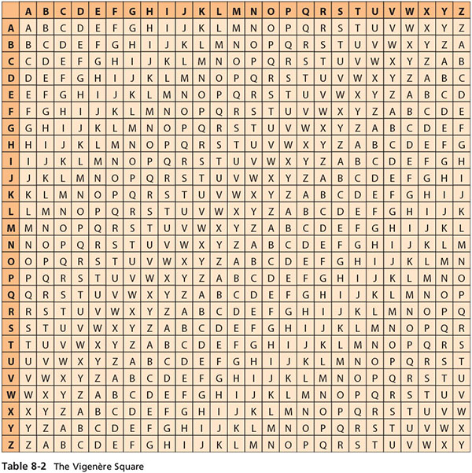
Notes:
Table 8-2 from Principles Ch 8

Slide 8
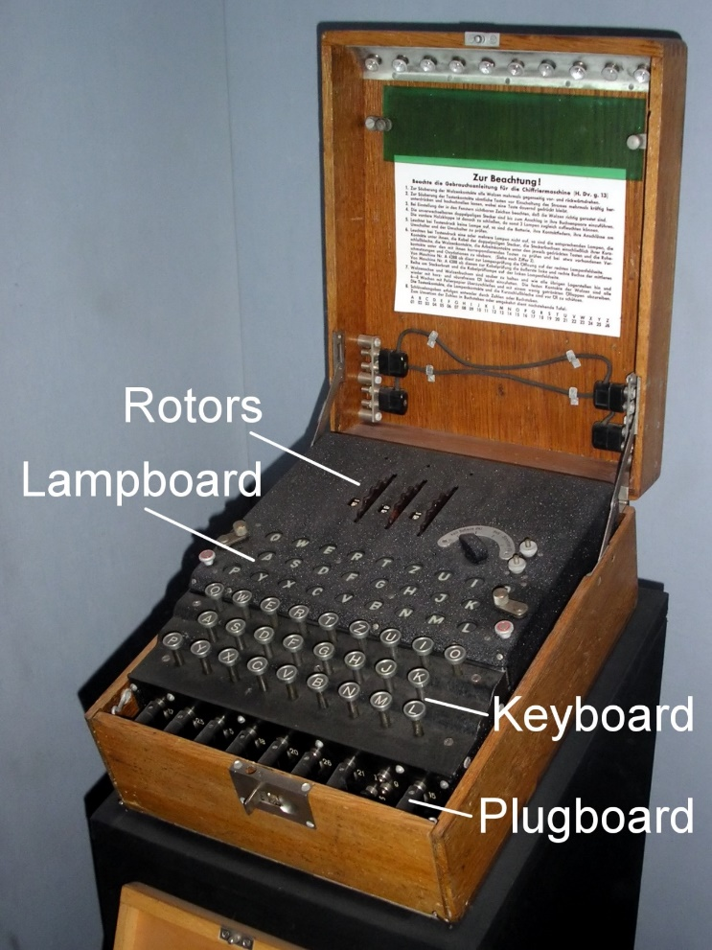
Cryptography in History
One of the most famous mechanical encryption machines was used by the Germans during World War II, known as Enigma
According to the Imperial War Museum, Polish mathematicians “had worked out how to read Enigma messages and had shared this information with the British” but couldn’t break the code quickly enough to be useful
Enter Alan Turing, brilliant mathematician, and his colleagues at Bletchley Park (where the secret work of decryption was being done)
Together, they created a machine known as the Bombe, which helped to significantly reduce the work of the code breakers
“With the help of captured Enigma material, and Turing’s work in developing a technique he called 'Banburismus', the naval Enigma messages were able to be read from 1941.”
Enigma Machine at the Imperial War Museum
Notes:
Image from: https://commons.wikimedia.org/wiki/File:EnigmaMachineLabeled.jpg (public domain)
From Imperial War Museum (https://www.iwm.org.uk/history/how-alan-turing-cracked-the-enigma-code), on Turing’s legacy: “In 1952, Alan Turing was arrested for homosexuality – which was then illegal in Britain. He was found guilty of ‘gross indecency’ (this conviction was overturned in 2013) but avoided a prison sentence by accepting chemical castration. In 1954, he was found dead from cyanide poisoning. An inquest ruled that it was suicide.
“The legacy of Alan Turing’s life and work did not fully come to light until long after his death. His impact on computer science has been widely acknowledged: the annual ‘Turing Award’ has been the highest accolade in that industry since 1966. But the work of Bletchley Park – and Turing’s role there in cracking the Enigma code – was kept secret until the 1970s, and the full story was not known until the 1990s. It has been estimated that the efforts of Turing and his fellow code-breakers shortened the war by several years. What is certain is that they saved countless lives and helped to determine the course and outcome of the conflict.”

Slide 9
One-Way Encryption – Hashing
Again, from NIST SP 800-175B : “A cryptographic hash function is a one-way function that is extremely difficult to invert. That is, it is not practical to reverse the process from the hash value back to the input” or “to find any two distinct inputs that map to the same output.”
It “maps a bit string of arbitrary length to a fixed-length bit string”
Common names for the output of a hash function are hash value and message digest
You can think of the message digest as a fingerprint of a message useful in integrity authentication
Often applied in digital forensics to show that a copied disk image has not been altered during analysis

Slide 10
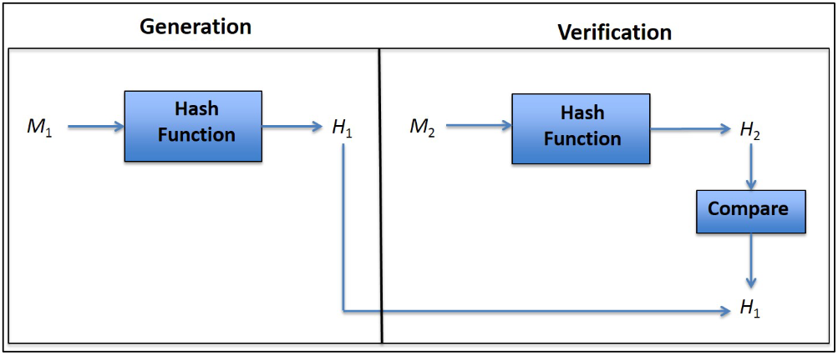
One-Way Encryption – Hashing
Hash Function Generation and Verification – from NIST SP 800-175B If H1 and H2 match, messages are identical (unaltered)
Notes:
Figure 1 from https://csrc.nist.gov/publications/detail/sp/800-175b/final

Slide 11
One-Way Encryption – Hashing
Hash functions are often used in password verification applications
Rather than send/store actual passwords that could be stolen, instead the hash value is calculated from the original password (often with random bits included, known as salt)
For more information on salting, see AddedBytes blog
The hash value is stored and when user logs in with password later, new hash value is created from their input and compared to one stored
In this way, the password itself need never be stored or transmitted directly
The rainbow table password attack (from earlier in this module) precomputes hash values for common passwords for use in attacks
This way cracker can just look up matching password for a given hash
Makes salting and other security techniques essential practices
Notes:
Approved Hash Functions from NIST include “SHA-1, SHA-224, SHA-256, SHA-384, SHA-512, SHA-512/224 and SHA-512/256” - from https://csrc.nist.gov/publications/detail/sp/800-175b/final

Slide 12
Encryption/Decryption Algorithms
For most other applications, ability to decrypt the ciphertext is desirable
These algorithms fall into broad categories known as symmetric and asymmetric approaches based on the types and number of keys used for encryption/decryption
In practice, today’s modern cryptographic systems often use a combination of both types, commonly known as hybrid cryptosystems

Slide 13
Symmetric-Key Algorithms
Symmetric-key algorithms use the same key to both encrypt and decrypt messages
As a consequence, it is essential that the key be kept secret if the information is to remain confidential
Also known as secret-key algorithms as a result
Many of these symmetric-key algorithms can be executed very quickly, even on less powerful computing devices
However, key management is a significant drawback to this approach

Slide 14

Symmetric-Key Algorithms
secret key
secret key
plaintext
ciphertext
plaintext
Message
A$6j!B%
Message
Alice
Bob
encrypt
decrypt

Slide 15
Symmetric-Key Algorithms
Key management is a significant drawback to this approach
In order to keep the key secure, it must be delivered to the recipient safely before a message can be decrypted
How does one deliver the key?
Can’t use same medium as message is to be sent over (easily intercept both key and ciphertext)
Must send separately, out of band, to avoid interception
Another problem is the increasing number of keys that must be managed for every pair of people communicating in a group
The number of combinations of k objects from a set with n objects is _{n} C ^{k}
_{n} C ^{k} = n! / [k! (n-k) !]
Notes:
Math from: https://home.ubalt.edu/ntsbarsh/Business-stat/otherapplets/comcount.htm

Slide 16
Symmetric-Key Algorithms
Key management is a significant drawback to this approach
Consider, 4 people (A,B,C,D) need to communicate with each pair having own secret key
How many combinations of keys for each pair is needed? 6 (A-B, A-C, A-D, B-C, B-D, and C-D)
What if we had 1000 people instead? Need at least 499,500 keys!
Quickly becomes unmanageable!
Notes:
Example and math from: from https://csrc.nist.gov/publications/detail/sp/800-175b/final
_{n} C ^{k} = 1000!/(2! * 998!) = 499,500

Slide 17
Symmetric-Key Algorithms
NIST has approved several symmetric-key algorithms for the protection of sensitive data – see NIST SP 800-175B
The Data Encryption Standard (DES) took effect in 1977 and was the first NIST-approved cryptographic algorithm
A block-cipher algorithm originally developed by IBM, it uses a key size of 56 bits and a block size of 64 bits
Block-cipher algorithms “map bit strings of a fixed length to bit strings of the same length”
It was used for over two decades but due to advances in computing power, it is no longer sufficient protection and was withdrawn for use in 2005
The Triple Data Encryption Algorithm (TDEA), or more commonly Triple DES, uses three keys that define a “key bundle”
Still approved for use when 3 mathematically independent keys are used for the 3 rounds of encryption

Slide 18
Symmetric-Key Algorithms
NIST has approved several symmetric-key algorithms for the protection of sensitive data – see NIST SP 800-175B
The Advanced Encryption Standard (AES) was developed to replace DES and is NIST’s preferred symmetric block cipher algorithm
Approved in 2002, the selection process involved competition from private industry, academia, and the U.S. government
AES uses the Rijndael Block Cipher on 128-bit blocks using keys of length 128- , 192-, or 256-bits
The performance of AES is “significantly better than that of” Triple DES

Slide 19
Asymmetric-Key Algorithms
Asymmetric-key algorithms use a pair of keys to encrypt and decrypt messages: a public key and a private key that are mathematically related to each other (see NIST SP 800-175B)
“The public key may be made public without reducing the security of the process, but the private key must remain secret if the data is to retain its cryptographic protection.”
“Even though there is a relationship between the two keys, the private key cannot efficiently be determined based on knowledge of the public key.”
Also known as public-key algorithms as a result
Whichever key is used to encrypt, the other key in the pair must be used to decrypt
The choice depends on what you want to accomplish, source authentication or confidentiality

Slide 20
Asymmetric-Key Algorithms
Asymmetric-key algorithms tend to be much slower to execute (requiring more processing power) than symmetric-key algorithms
Not used to process large amounts of data
However, requires significantly fewer keys than symmetric-key algorithms do
A unique key pair does not need to be created for each relationship
So, for 1000 people would only need 1000 key pairs for each intended purpose (vs. the 499,500 keys needed with symmetric!)
Private key is kept by the owner and must be kept secret and its integrity protected
Public key is usually distributed to others through Public Key Infrastructure (PKI)
Notes:
From https://csrc.nist.gov/publications/detail/sp/800-175b/final

Slide 21
Asymmetric-Key Algorithms
Again, from NIST SP 800-175B : Public Key Infrastructure (PKI) “is a security infrastructure that creates and manages public-key certificates to facilitate the use of public-key (i.e. asymmetric-key) cryptography.”
“Certification authorities (CAs) generate certificates and certificate-status information, and
“Registration authorities (RAs) verify the identity of users applying for a certificate and authenticate other information to be included in the certificate.”
Notes:
From https://csrc.nist.gov/publications/detail/sp/800-175b/final

Slide 22
Asymmetric-Key Encryption for Confidentiality
Bob’s public key
Bob’s private key
plaintext
ciphertext
plaintext
Message
A$6j!B%
Message
Alice
Bob
encrypt
decrypt
Alice wants to send a message that only Bob can read, so she encrypts with Bob’s public key Only Bob will be able to decrypt the message (even if intercepted) as only he has his private key

Slide 23
Asymmetric-Key Encryption for Source Authentication
Alice’s private key
Alice’s public key
plaintext
ciphertext
plaintext
Message
A$6j!B%
Message
Alice
Bob
encrypt
decrypt
Alice wants to send a message that anyone can read, but could only have come from her If Bob can decrypt the message with Alice’s public key, it must have come from her (private key)

Slide 24
Asymmetric-Key Algorithms
A digital signature algorithm is used with public and private keys to generate and verify digital signatures providing “assurance of data integrity, and source authentication, and to support non-repudiation.” – from NIST SP 800-175B
Digital signature generation is done using the signer’s private key and anyone can verify the signature by employing the associated public key
The signer’s message is run through a hash function, generating hash value 1
The hash value is encrypted with the signer’s private key, creating the digital signature
When recipient receives the message, they hash separately generating hash value 2
Recipient decrypts attached signature with signer’s public key, returning hash value 1
If the calculated hash value (2) and the extracted hash value (1) match, the message was not altered and must have been signed by public key’s owner
Notes:
From https://csrc.nist.gov/publications/detail/sp/800-175b/final

Slide 25
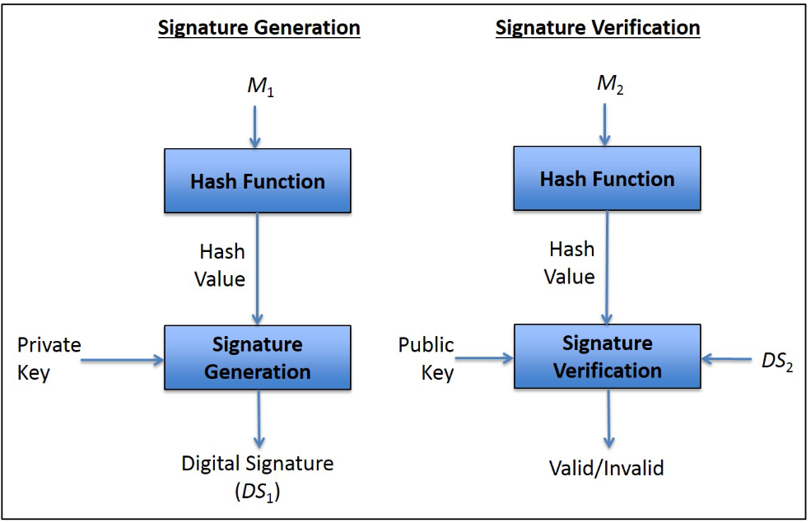
Digital Signatures
Digital Signature Generation and Verification – from NIST SP 800-175B
Notes:
Figure 4 from https://csrc.nist.gov/publications/detail/sp/800-175b/final

Slide 26
Asymmetric-Key Algorithms
NIST has approved several asymmetric-key algorithms for the protection of sensitive data – see NIST SP 800-175B
The Digital Signature Algorithm (DSA) “is used to generate and verify digital signatures using finite-fields” (for more on the math, see Wolfram MathWorld)
The RSA algorithm (named for its creators’ last names – Rivest, Shamir, and Adleman) is one of the first and most popular asymmetric-key cryptosystems
Developed in 1977, the RSA algorithm is NIST-approved for the generation and verification of digital signatures and for key establishment (in hybrid cryptosystem use).
Notes:
From https://csrc.nist.gov/publications/detail/sp/800-175b/final

Slide 27
Hybrid Cryptosystems
“Since asymmetric-key (i.e. public-key) cryptography requires fewer keys overall, and symmetric-key cryptography is significantly faster, a hybrid approach is often used, whereby asymmetric-key algorithms are used for the generation and verification of digital signatures and for key establishment, while symmetric-key algorithms are used for …encryption, especially those involving the protection of large amounts of data.
“For example, an asymmetric-key system can be used to establish a symmetric key via a key-agreement or key-transport process, after which the symmetric key is used to encrypt files or messages.”– see NIST SP 800-175B
The Diffie-Hellman algorithm is one such type of system

Slide 28

Hybrid Cryptosystems
Diffie-Hellman Key Exchange video – Khan Academy/Art of the Problem

Slide 29
Securing Communication through Encryption
S-HTTP (Secure Hypertext Transfer Protocol) and SSL (Secure Sockets Layer) are communication protocols designed to allow secure network communication over the Internet
Now, HTTP over TLS (HTTPS) is more commonly used
TLS (Transport Layer Security) replaces SSL
In April 2014, a serious vulnerability in the popular OpenSSL cryptographic software library was discovered, named HeartBleed
“This weakness allows stealing the information protected, under normal conditions, by the SSL/TLS encryption used to secure the Internet.” – see heartbleed.com

Slide 30
Securing Communication through Encryption
The original (and still widely used) e-mail protocols did little to protect the confidentiality of messages sent between users on the Internet or authenticate the source of the sender
Several cryptosystems have been tweaked to work with the popular e-mail protocols in order address this shortcoming
S/MIME (Secure Multipurpose Internet Mail Extensions) protocol allows you to encrypt and “digitally sign your emails to verify you as the legitimate sender of the message, making it an effective weapon against many phishing attacks out there.” – GlobalSign Blog
PGP (Pretty Good Privacy) has become one of the most popular open source cryptosystems for encryption of e-mail – see OpenPGP.org for more
OpenPGP was standardized in 1997, based on the original PGP software created by Phil Zimmermann

Slide 31
Securing Communication through Encryption
TCP/IP (as you learned in the previous module), is a family of protocols used for networking on the Internet
As with e-mail, the original TCP/IP protocols did not consider confidentiality to be an important consideration
IP Security (IPSec) is a “framework of open standards for ensuring private, secure communications over Internet Protocol (IP) networks, through the use of cryptographic security services.” – Microsoft TechNet
It is also considered the security system of the next generation of IP (IPV6)

Slide 32
Securing Communication through Encryption
A Virtual Private Network (VPN) uses encryption to allow users to connect a private network (like used at work) through the open Internet
IPSec is commonly used to create VPN connections – see Calyptix Security
In IPSec transport mode, a packet’s IP data is encrypted but not the IP headers, so source and end destination addresses may be seen
In IPSec tunnel mode, the entire IP packet is encrypted and inserted (like an envelope inside another larger envelope) as the data of another IP packet
Requires other systems at the beginning and end of the tunnel to act as proxies between the actual source and ultimate destination addresses
Actual source and destination addresses may not be seen, only the proxies

Slide 33
Securing Communication through Encryption
Securing WiFi communication is essential given how many devices are now connecting to networks wirelessly
The (woefully misnamed) Wired Equivalency Protocol (WEP) was an early attempt to provide encryption for WiFi devices
Introduced as part of the original 1997 IEEE 802.11 standard, WEP was soon found to be vulnerable to key attacks that put its confidentiality at risk
WEP was superseded by Wi-Fi Protected Access (WPA) in 2003 and WPA2 in 2004
WPA2 became mandatory for all new Wi-Fi devices in 2006
In January 2018, WPA3 was announced – see Wi-Fi Alliance press release

